Slide 1
Tuesday, November 1, 2016
Write In Your Agenda:
Write In Your Monitoring Log:
CW:
Volcano Pre-reading and Comprehension Squares
Volcano Power Point and Notes
HW:
Study for Earthquake Quiz on Thursday
Response to Warm-Up:
Name two things you already know about volcanoes.
You will need:
Pencil
New Monitoring Log (green)

Slide 2
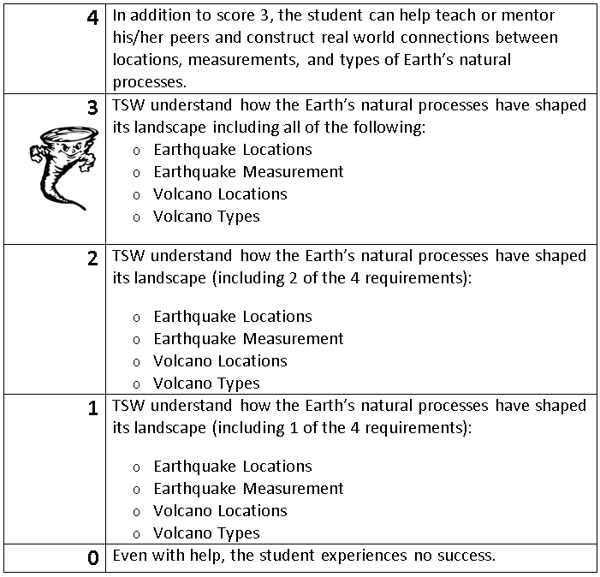
Learning Goal and Scale
TSW understand how the Earth’s natural processes have shaped its landscape (including Earthquake locations and how they are measured as well as Volcano locations and the three types).

